Slide 1
Employee Data Analysis using Excel
STUDENT NAME: RAMYA DEVI M
REGISTER NO: C4C2977658180329C12412DD2AAA218B/312208751
DEPARTMENT: B.COM(GENERAL)
COLLEGE: MEENAKSHI COLLEGE FOR WOMEN

Slide 2
PROJECT TITLE
Employee Performance Analysis using Excel
EMPLOYEE PERFORMANCE DATASET ANALYSIS BASED ON GENDER,DEPARTMENT,SALARY WITH USING EXCEL

Slide 3


AGENDA
Problem Statement
Project Overview
End Users
Our Solution and Proposition
Dataset Description
Modelling Approach
Results and Discussion
Conclusion
3/21/2024 Annual Review

Slide 4

PROBLEM STATEMENT
The organization seeks to address potential inequities in employee compensation by analyzing the interplay between salary, department, and gender. The primary goal is to uncover any disparities that may exist in salary distributions across different departments and between genders. Specifically, the organization wants to determine if average salaries vary significantly by department and whether these variations are influenced by gender. Additionally, the organization aims to identify if certain departments exhibit more pronounced gender-based salary discrepancies. To achieve this, the analysis will involve examining salary data alongside departmental affiliations and gender information, employing statistical methods to highlight any significant differences or trends. The ultimate objective is to ensure fair and equitable compensation practices by addressing any identified disparities and making informed recommendations for policy adjustments or further investigations.

Slide 5

PROJECT OVERVIEW
The project aims to analyze employee salaries with a focus on departmental and gender-based disparities to ensure fair compensation practices within the organization. By systematically examining salary data segmented by department and gender, the project seeks to identify any significant differences and trends that may indicate inequities. The analysis will involve calculating and comparing average salaries across various departments and evaluating how these salaries vary by gender. Additionally, the project will explore whether certain departments exhibit more pronounced gender-based salary discrepancies. The findings will be compiled into a comprehensive report, highlighting key insights and providing actionable recommendations to address any identified disparities. Ultimately, the goal is to promote equity and transparency in compensation practices, contributing to a more inclusive and fair workplace environment.

Slide 6

WHO ARE THE END USERS?
The end users of an analysis focusing on gender, department, and salary in employee performance are primarily the Human Resources (HR) department, organizational leadership, and employees themselves. HR professionals utilize the analysis to review and adjust compensation practices, ensuring they align with fairness and equity goals. Organizational leaders, including executives and managers, rely on these insights to make informed decisions about policy changes, resource allocation, and strategic initiatives to enhance workplace culture and performance. Employees are the ultimate beneficiaries, as the findings can lead to more transparent and equitable compensation structures, fostering a more inclusive work environment and potentially improving overall job satisfaction and performance. By addressing disparities and promoting fairness, the analysis aims to create a more balanced and motivated workforce.

Slide 7

OUR SOLUTION AND ITS VALUE PROPOSITION
Our solution offers a comprehensive analysis of employee salaries, focusing on departmental and gender-based disparities, to ensure equitable compensation and enhance organizational fairness. By leveraging detailed data analysis, we identify and quantify salary differences across departments and between genders, providing actionable insights that drive informed decision-making. The value proposition of our solution lies in its ability to uncover hidden inequities, facilitate transparent compensation practices, and promote a more inclusive workplace environment. This approach not only aligns with best practices in diversity, equity, and inclusion but also supports organizational goals by fostering a motivated and fairly compensated workforce. Ultimately, our solution helps the organization build trust, improve employee satisfaction, and optimize overall performance through data-driven strategies.

Slide 8
Dataset Description
The dataset for this analysis comprises detailed records of employee salaries, departmental affiliations, and gender identities. Each entry includes individual employee identifiers, their respective annual salaries, the department in which they work, and their gender. The salary data is provided as annual figures, allowing for direct comparison and aggregation. Departmental information categorizes employees into distinct organizational units, such as Marketing, Sales, or Engineering, while gender data includes classifications such as Male, Female, and Non-binary. This dataset enables a nuanced examination of salary distributions across various departments and between genders, facilitating the identification of any disparities and trends. It is crucial for conducting a thorough and accurate analysis aimed at promoting equitable compensation practices and improving overall organizational fairness.

Slide 9

THE "WOW" IN OUR SOLUTION
The "wow" in our solution lies in its transformative approach to achieving fairness and equity in compensation through advanced data analysis. By integrating detailed salary, department, and gender data, we not only reveal hidden disparities but also provide actionable insights that can lead to meaningful change. The solution’s sophisticated analytical methods uncover nuanced patterns and intersections that traditional approaches might miss, enabling precise identification of inequities. Additionally, the visually compelling and user-friendly reports make complex data accessible and understandable for stakeholders at all levels. This empowers the organization to make informed, data-driven decisions that promote a more inclusive and motivated workforce. The true impact is seen in how our solution drives real, positive change within the organization, fostering a culture of transparency and fairness that enhances employee satisfaction and performance.
3/21/2024 Annual Review
9

Slide 10
MODELLING
Modeling the impact of gender on salary and its effects on employee performance involves analyzing how gender disparities in compensation influence workplace outcomes. This approach typically uses statistical methods and data analysis to examine the relationships between gender, salary levels, and performance metrics. For example, a model might explore whether discrepancies in salary based on gender correlate with variations in job performance, employee satisfaction, and career progression. By incorporating variables such as job role, experience, and education level, the model aims to isolate the effects of gender on salary and performance. This analysis can reveal patterns that suggest whether unequal pay contributes to differences in performance or if other factors might be at play. Ultimately, such modeling helps organizations identify and address potential biases in compensation practices, ensuring that all employees are fairly rewarded and motivated, which in turn can enhance overall performance and productivity.
10

Slide 11
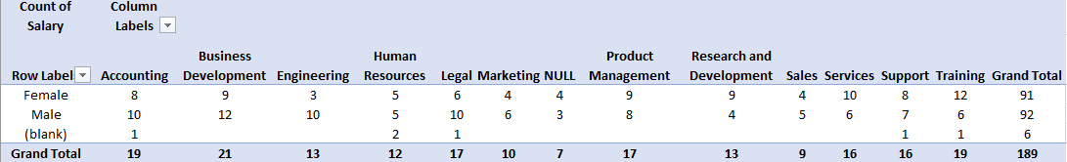
RESULTS
11

Slide 12
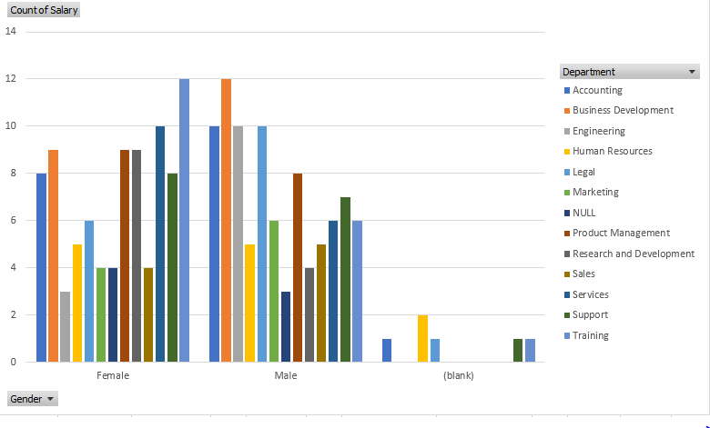
RESULTS

Slide 13
conclusion
In conclusion, analyzing an overall employee performance dataset with a focus on gender and salary and department, using Excel, provides profound insights into workplace dynamics. Through Excel's powerful tools, including tables and diagrams, we can efficiently sort, filter, and visualize data to uncover patterns and correlations. This analysis reveals how salary disparities between genders may impact performance metrics and highlights areas for improvement in compensation practices. By utilizing Excel's functions, such as pivot tables, charts, and conditional formatting, we can present complex data in an accessible format, facilitating clearer understanding and decision-making. This approach not only helps in identifying potential biases but also aids in developing targeted strategies to ensure fair and equitable treatment of all employees, ultimately fostering a more balanced and productive work environment.

